Slide 1

 | S.S.V.P.S’s B. S. Deore Polytechnic, Dhule Department of Computer Engineering Academic Year : 2025 – 2026
Presentation on Capstone Project Execution (CPE–316004)
Topic | Co Attainment Calculation For Outcome Based Education
Presented by | 1.Ruchika Dilip Patil.
 | 2.Krishna VinodKumar Popali.
 | 3.Aman Anjum Iqbal Shaikh.
 | 4.Suvarna Mahendra Sonawane.
Guided by | Ms. Chaitali S. Patil
Semester | Sixth (K Scheme) | Date ://2026

Slide 2
Abstract
This project presents a system that will support continuous academic evaluation during the ongoing teaching process. The system will enable teachers to submit assessment data through a centralized platform, where performance levels will be processed using predefined rubrics. Based on this evaluation, the system will identify attainment status and highlight the gap between expected and achieved outcomes. The generated results will be presented in a structured report format, allowing timely review within the same academic Assessment. By providing immediate analytical feedback, the system will support informed academic decisions and will help faculty focus on improving instructional effectiveness rather than manual data processing.

Slide 3
Content
Introduction (background of the industry or used based problem / task)
Literature Survey
Scope of the project
Methodology
Details of designs, working and processes
Results and applications
Conclusion and future scope
References and Bibliography

Slide 4
1. Introduction
In academic institutions, the evaluation of student performance requires systematic analysis to understand learning effectiveness. Traditionally, this evaluation process involved maintaining student assessment records separately and performing calculations after completion of assessments. Such practices limited the ability to observe performance trends during the teaching period. Since the evaluation was carried out at a later stage, instructors had minimal opportunity to adjust teaching strategies for the same group of students. Additionally, the dependence on manual record handling increased processing time and reduced efficiency. These challenges highlight the importance of adopting structured mechanisms that support timely performance analysis and enable instructional refinement within the academic term.

Slide 5
2. Literature Review
Earlier studies show that many institutions calculate attainment levels using spreadsheet-based methods. In this process, teachers manually enter student marks and later calculate attainment values and performance gaps. This calculation is usually done after completing all assessments of the course. Because of this delay, teachers cannot explain the results or the identified gaps to the current batch of students during the same academic term. The analysis becomes useful mainly for the next batch, where teachers can plan assignments or improvements based on the previously identified gaps. However, the current batch does not get immediate feedback about their performance or the areas where improvement is required. This limitation highlights the need for a system that can provide timely analysis and support better academic monitoring.

Slide 6
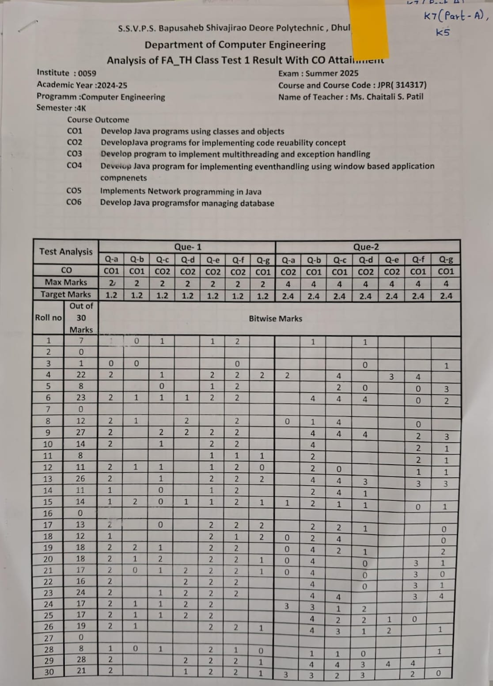
2. Literature Review
Fig. Bitwise Class Test 1 Calculation

Slide 7
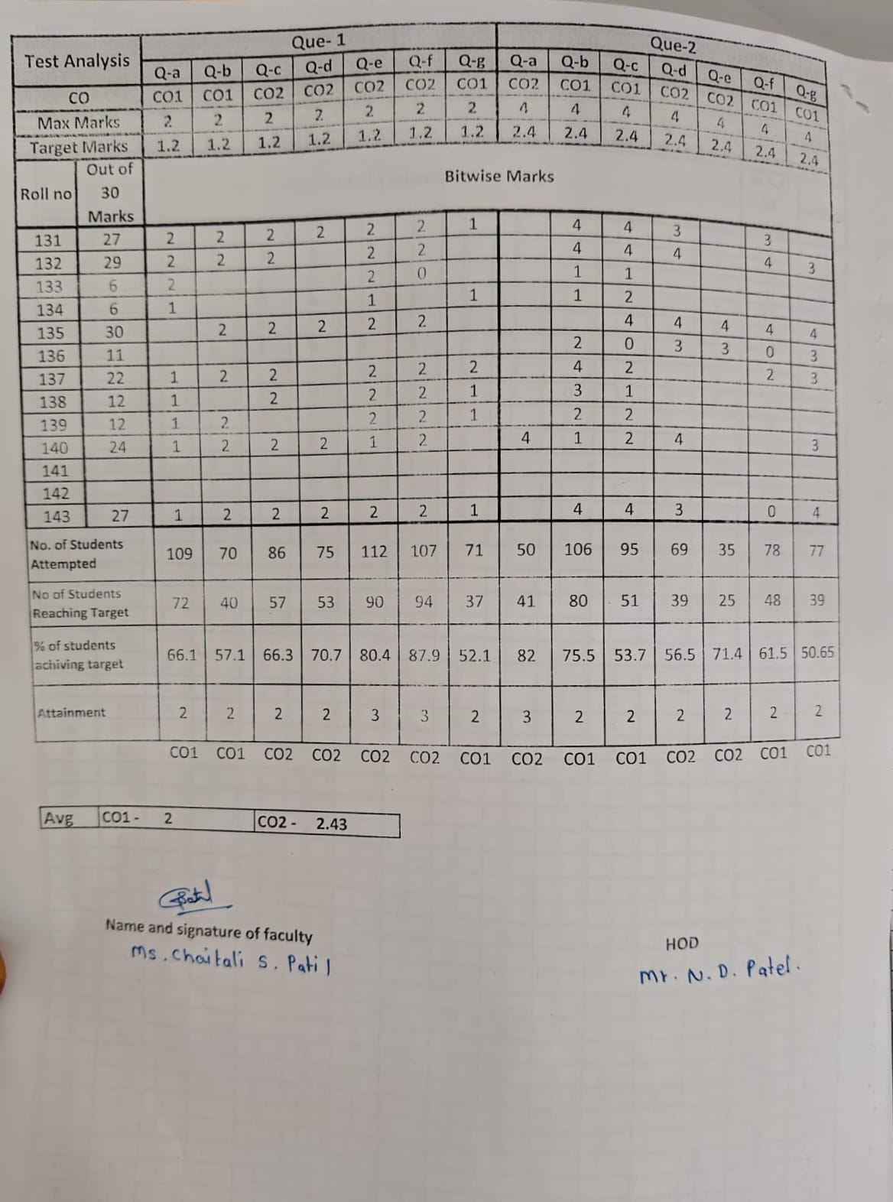
2. Literature Review
Fig. Bitwise Class Test 1 Calculation

Slide 8
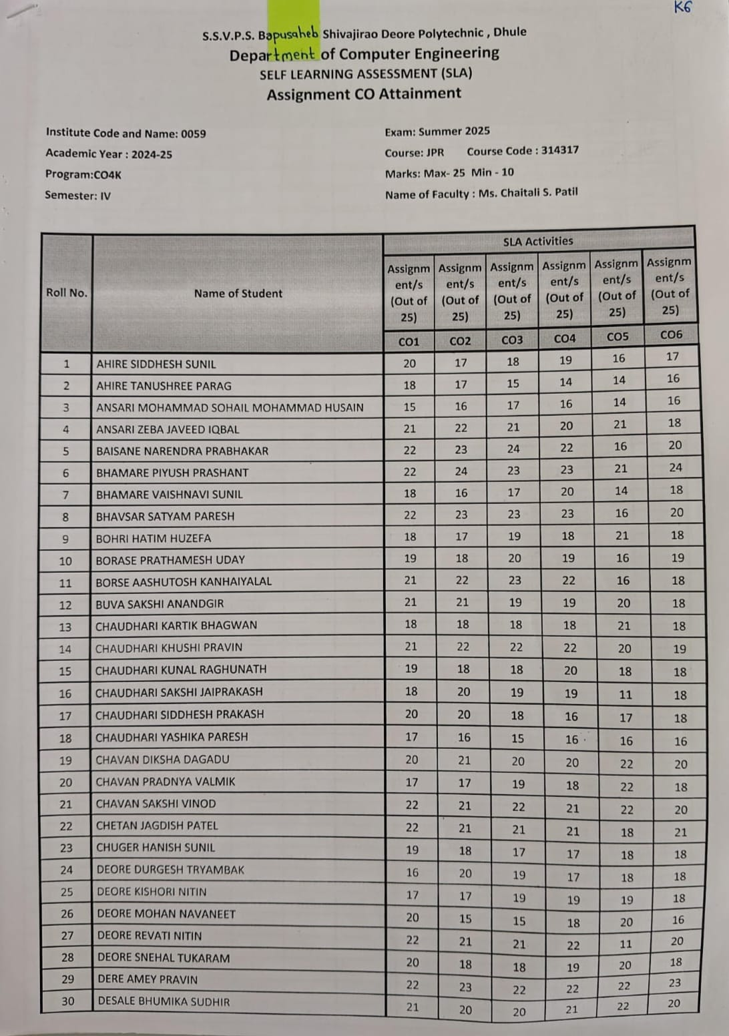
2. Literature Review
Fig.(SLA)Self Learning Assessment

Slide 9
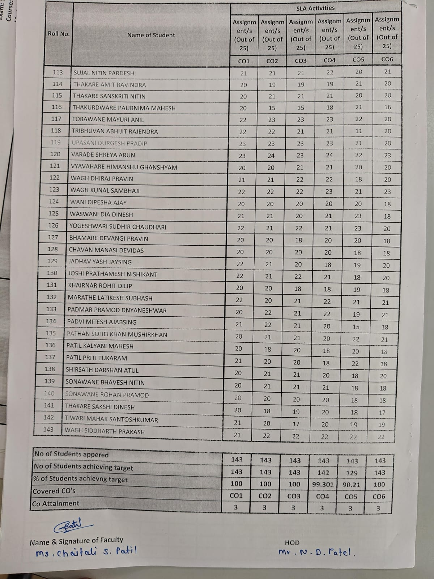
2. Literature Review
Fig.(SLA)Self Learning Assessment

Slide 10
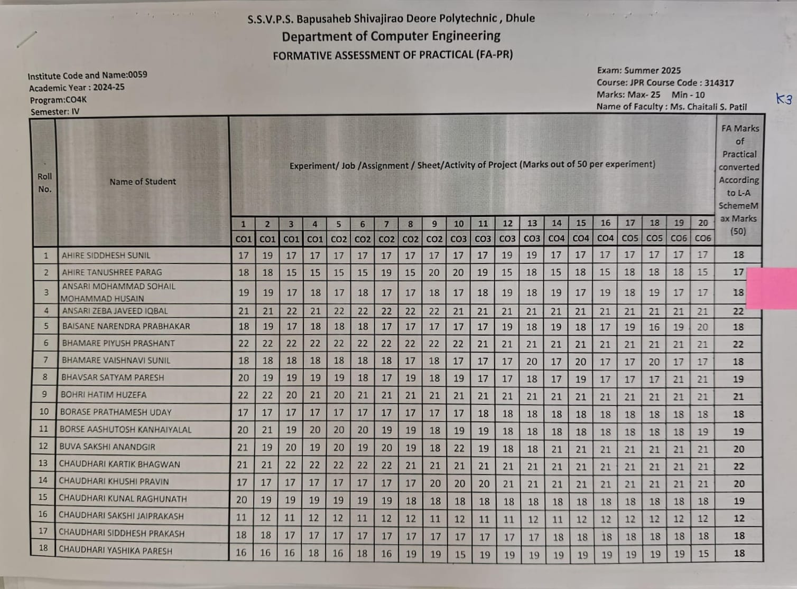
2. Literature Review
Fig.(FA-PR) Formative Assessment Of Practical

Slide 11
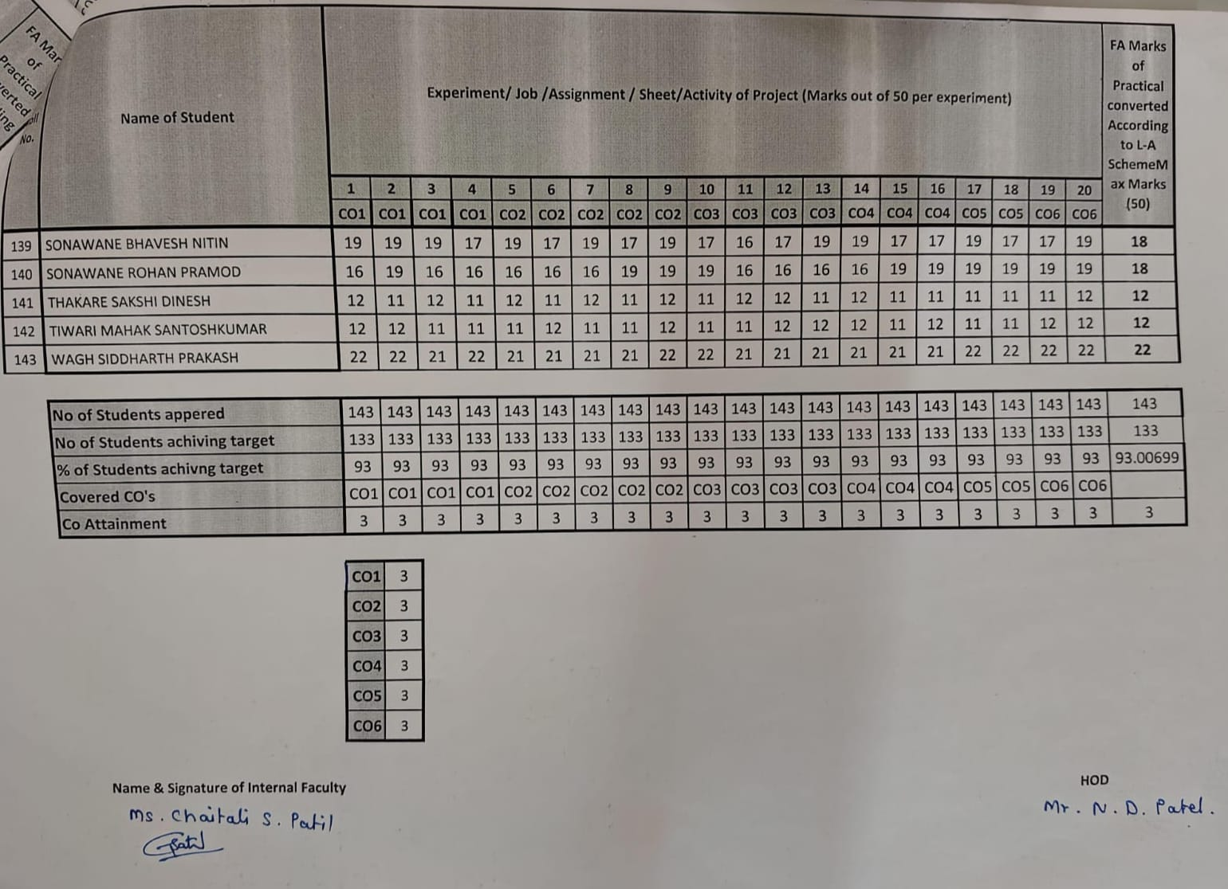
2. Literature Review
Fig.(FA-PR) Formative Assessment Of Practical

Slide 12
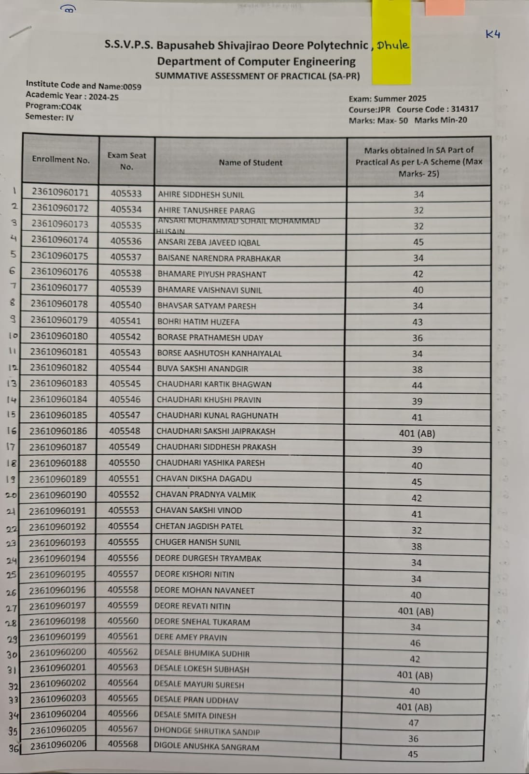
2. Literature Review
Fig. (SAPR)-Summative Assessment Of Practical

Slide 13
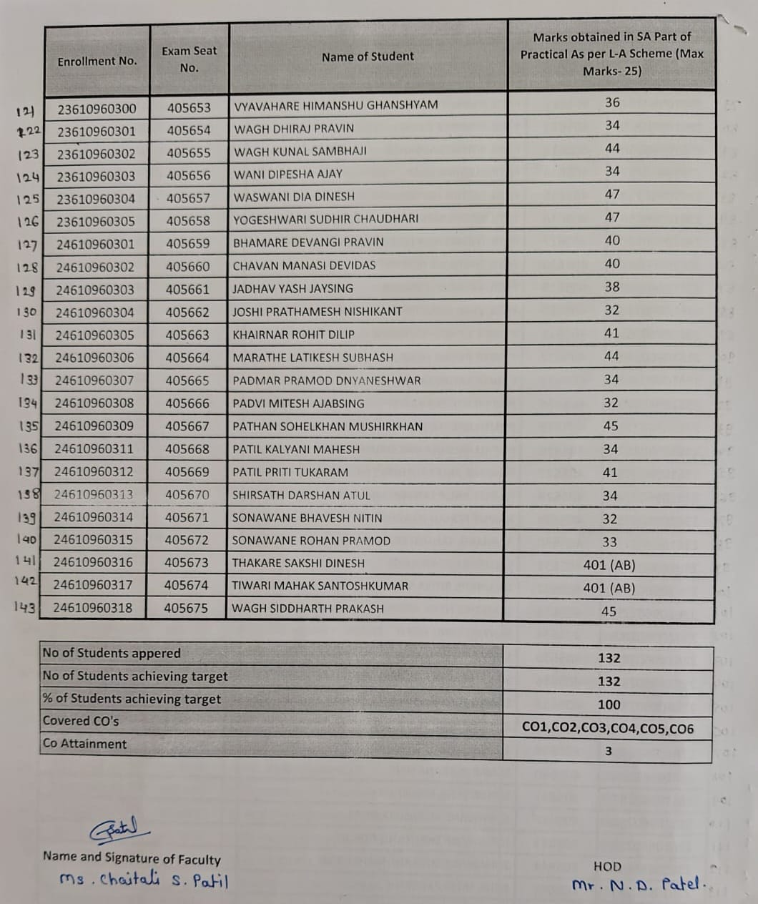
2. Literature Review
Fig. (SA-PR)-Summative Assessment Of Practical

Slide 14
3. Scope of the project
The scope of this project is defined within the academic framework of institutes affiliated under MSBTE. The system is intended for implementation at S.S.V.P.S’s B. S. Deore Polytechnic, Dhule, specifically within the Computer Engineering Department. It supports internal academic evaluation processes followed under various curricula such as the K Scheme and I Scheme. The project focuses on subject-wise performance analysis for the current batch of students and provides structured support to faculty members and administrative authorities. Its scope includes attainment calculation, rubrics-based classification, gap identification, and generation of analytical reports for internal academic review. The project is limited to institutional-level evaluation support and does not extend to external examination or result processing systems.

Slide 15
4. Methodology
Technologies used:-
1. Django(Python):-Used for backend development. It processes the uploaded SRS file, performs validation, applies NLP techniques, and handles communication with the database.
- https://www.python.org/doc/
2. Sqlite3:- Used as the database to store user and admin data.
- https://www.sqlite3.com/docs/
Frontend:- Django templates (HTML/CSS/JS), Bootstrap, jQuery, DataTables . JSON Fields: Used extensively to store flexible schemas (e.g., subjects_data, students_data, student_marks, configs).

Slide 16
4. Methodology
The system is a web-based application designed to automate CO attainment calculation for SSVPS College.
It allows faculty to enter and manage student assessment data in a structured and accurate way.
The system automatically calculates CO attainment percentages after uploading student scores.
It helps in monitoring student performance and identifying learning gaps early.
Graphical visualizations (like bar charts) support analysis and reduce manual effort with real-time monitoring.

Slide 17
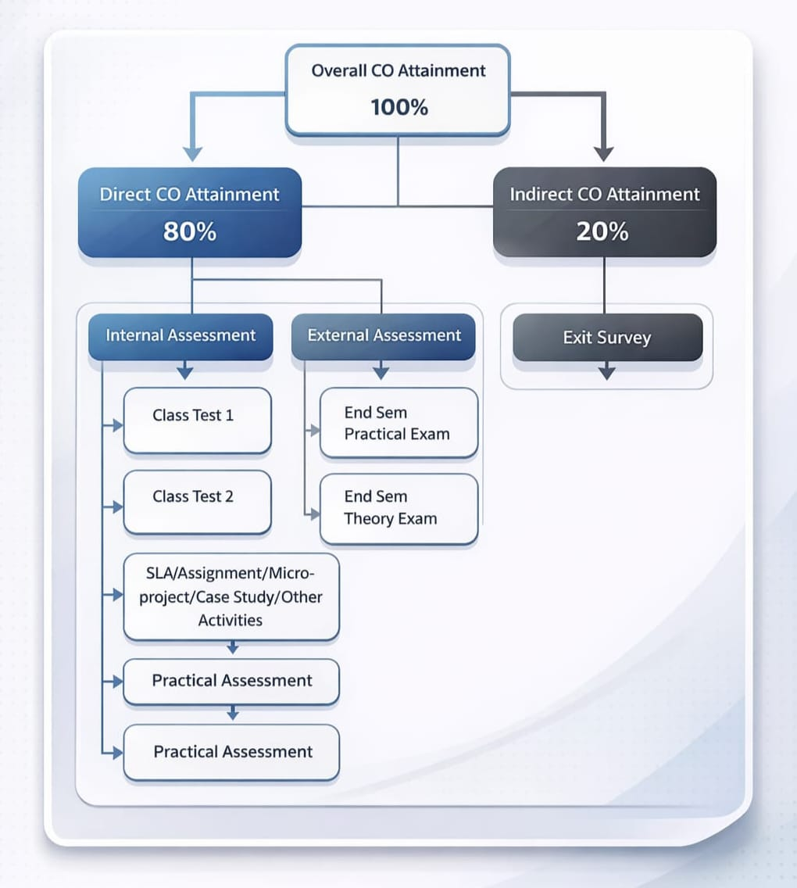
5. Details of designs, working & processes
Fig.CO-Attainment Process

Slide 18
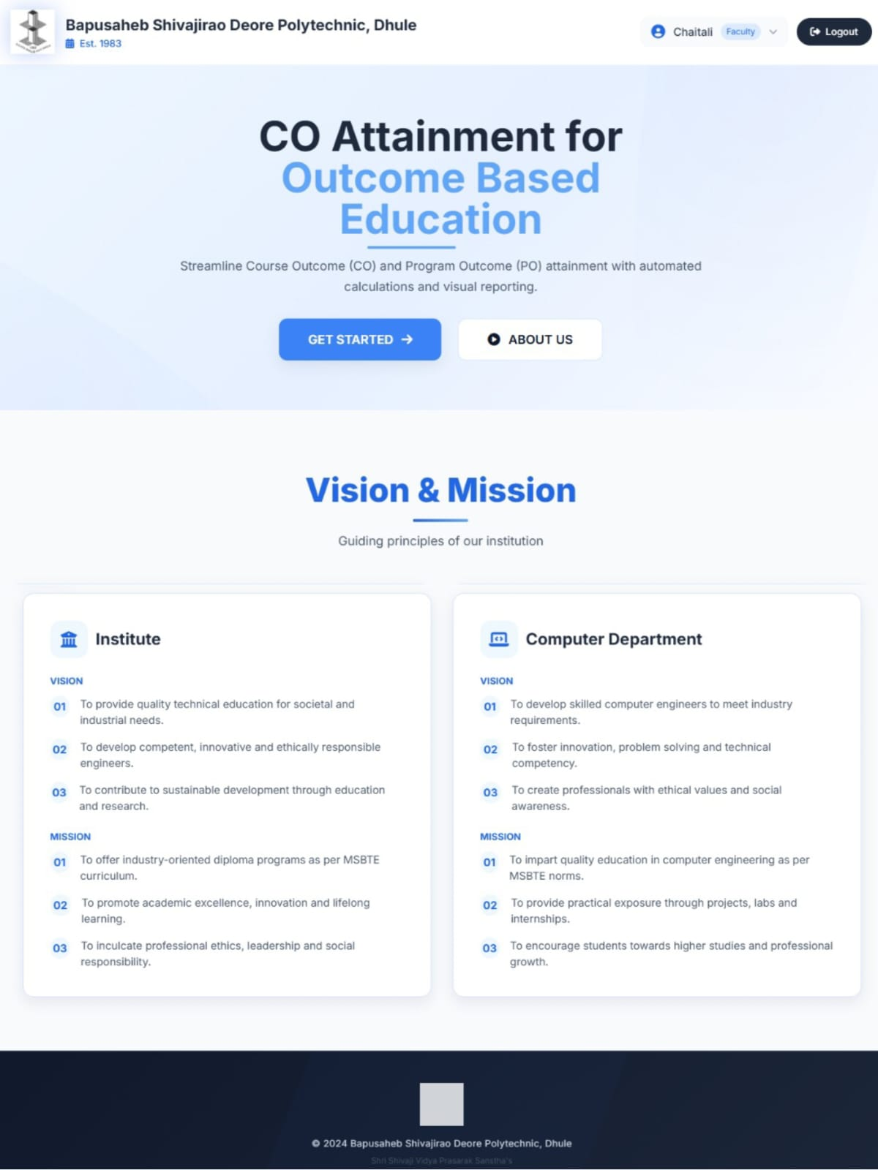
6. Results and Applications
Home Page :-
This is the home page of the CO Attainment System. It provides an overview of the system and its purpose, which is to calculate Course Outcome attainment automatically. The page also displays the institute and department vision and mission to highlight the academic objectives of the institution.

Slide 19
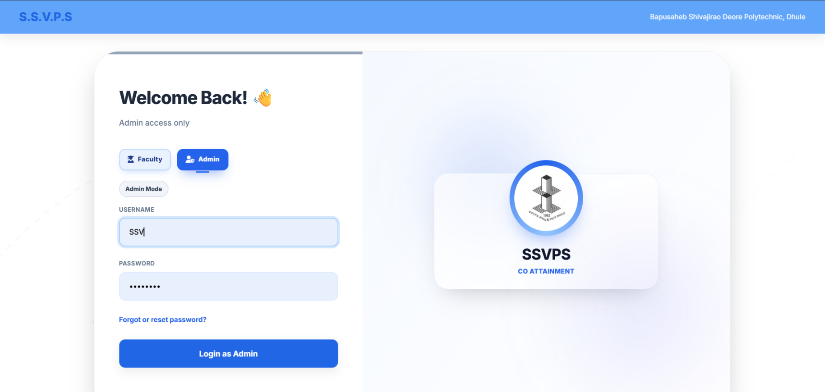
6. Results and Applications
Login Page:- This page provides secure access to the system through the Admin login interface. The administrator enters valid login credentials to access the system. After successful login, the admin can manage academic batches, courses, and CO attainment related data within the system.

Slide 20
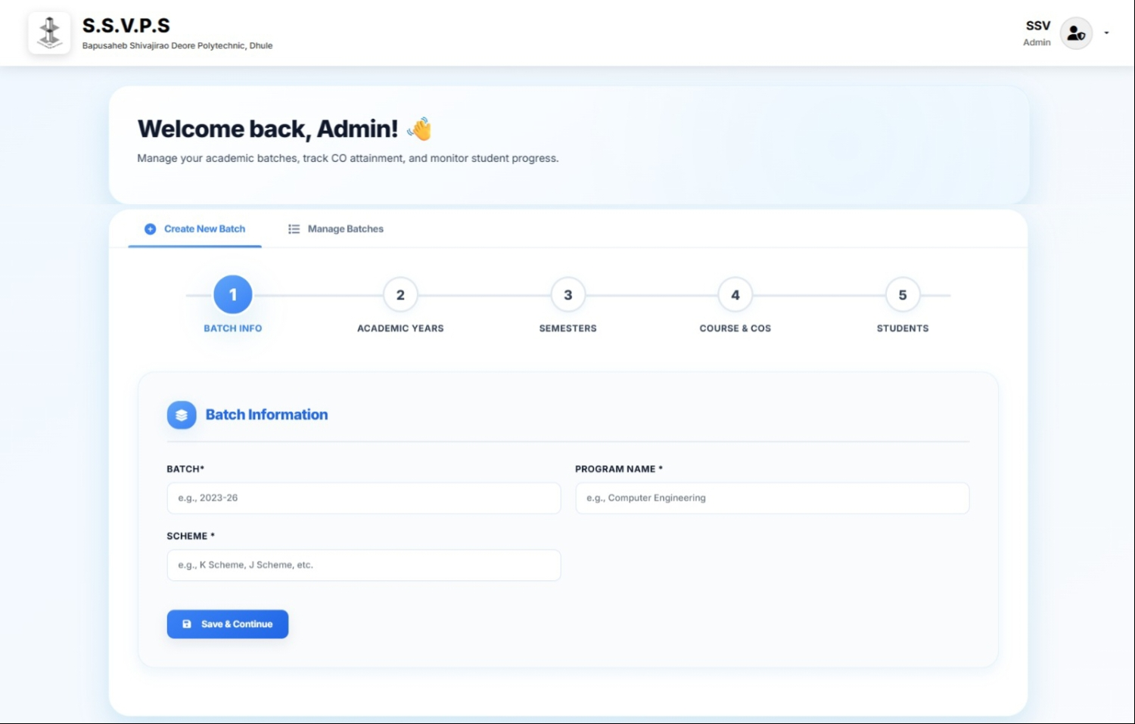
6. Results and Applications
Admin Dashboard (Create Batch):- This page allows the admin to create and manage academic batches. The admin enters important details . These details help organize student and course information for CO attainment calculation.

Slide 21
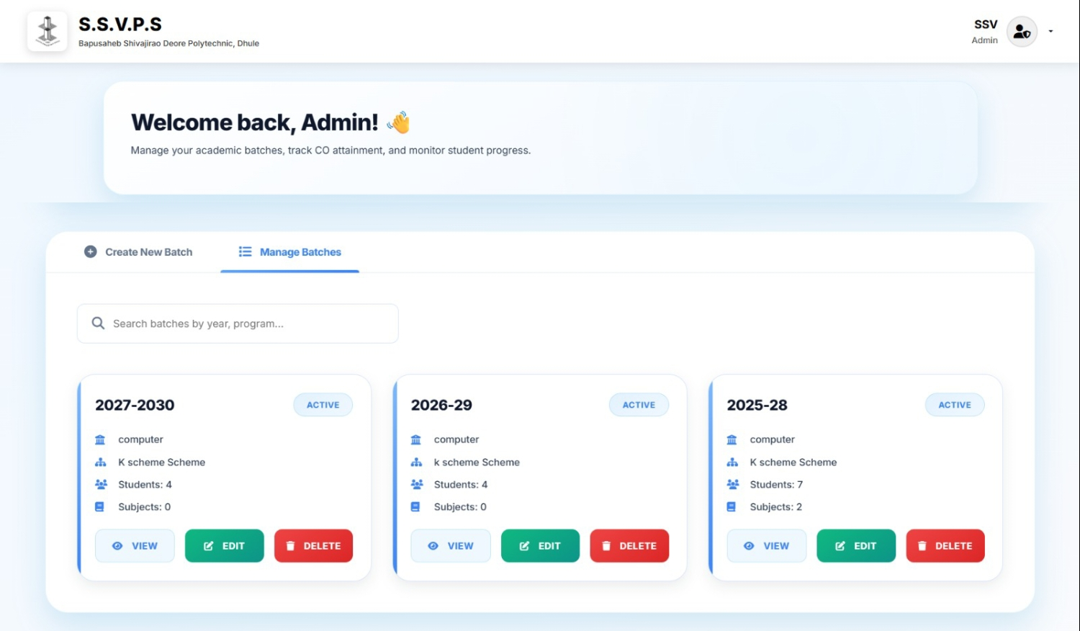
6. Results and Applications
Manage Batches:- This page displays all the created batches in the system. The admin manage batch information and check the number of students and subjects in each batch. It helps in managing academic records efficiently.

Slide 22
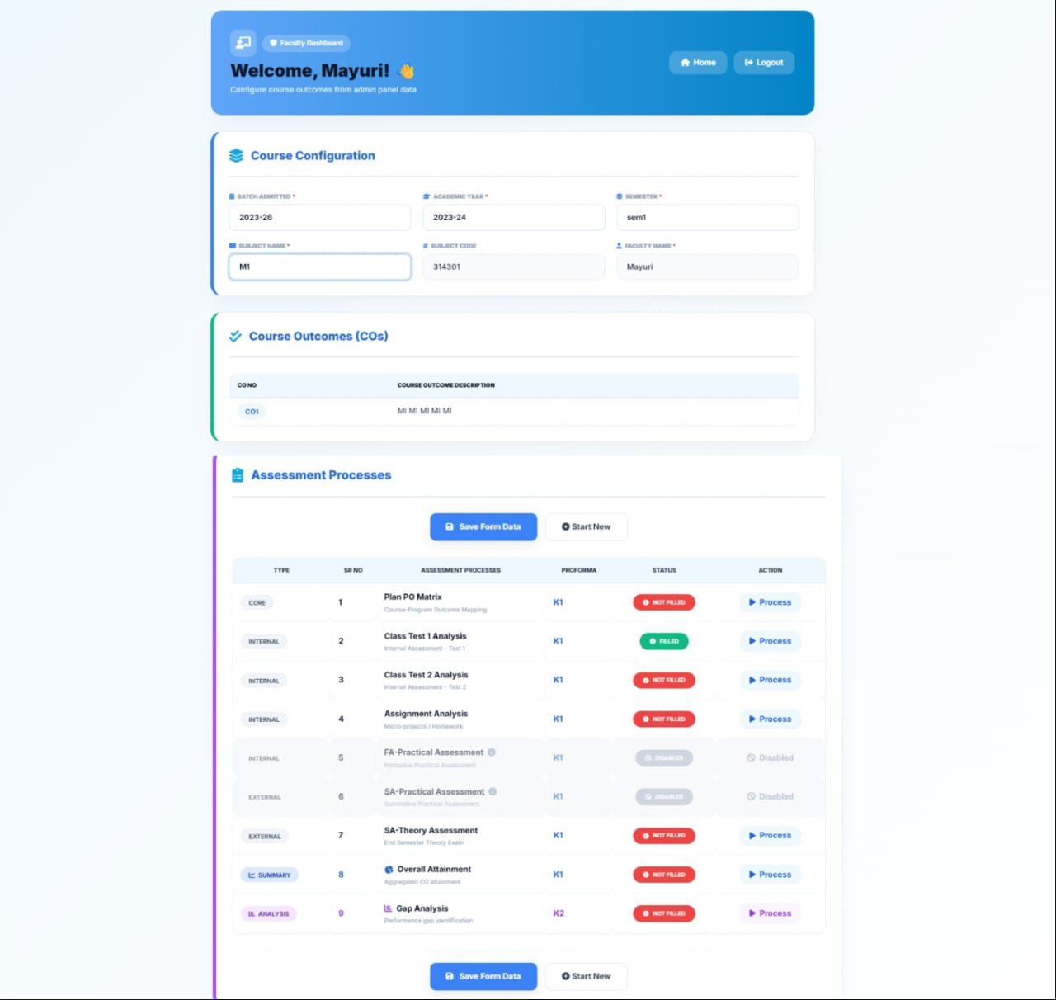
6. Results and Applications
Course Configuration:-This interface shows the Teacher Module, where teachers configure course details and define Course Outcomes (COs). It also provides different assessment processes such as PO Matrix mapping, class test analysis, assignment evaluation, and overall attainment calculation.

Slide 23
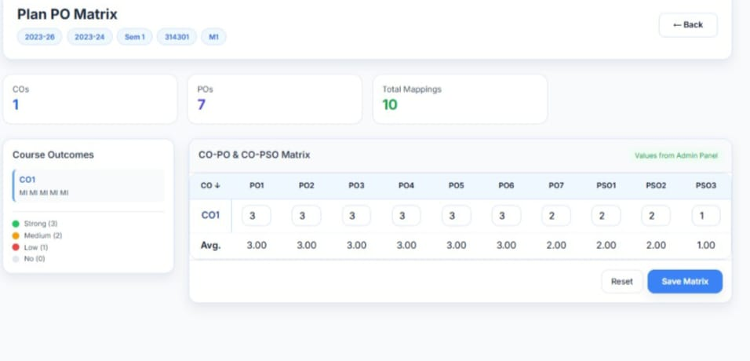
6. Results and Applications
Plan PO Matrix Interface:-This interface shows the CO-PO & CO-PSO Matrix, where Course Outcomes are mapped with Program Outcomes and PSOs. The course and subject details configured in the Admin Panel are automatically reflected here, enabling teachers to define and save the PO mapping for assessment.

Slide 24
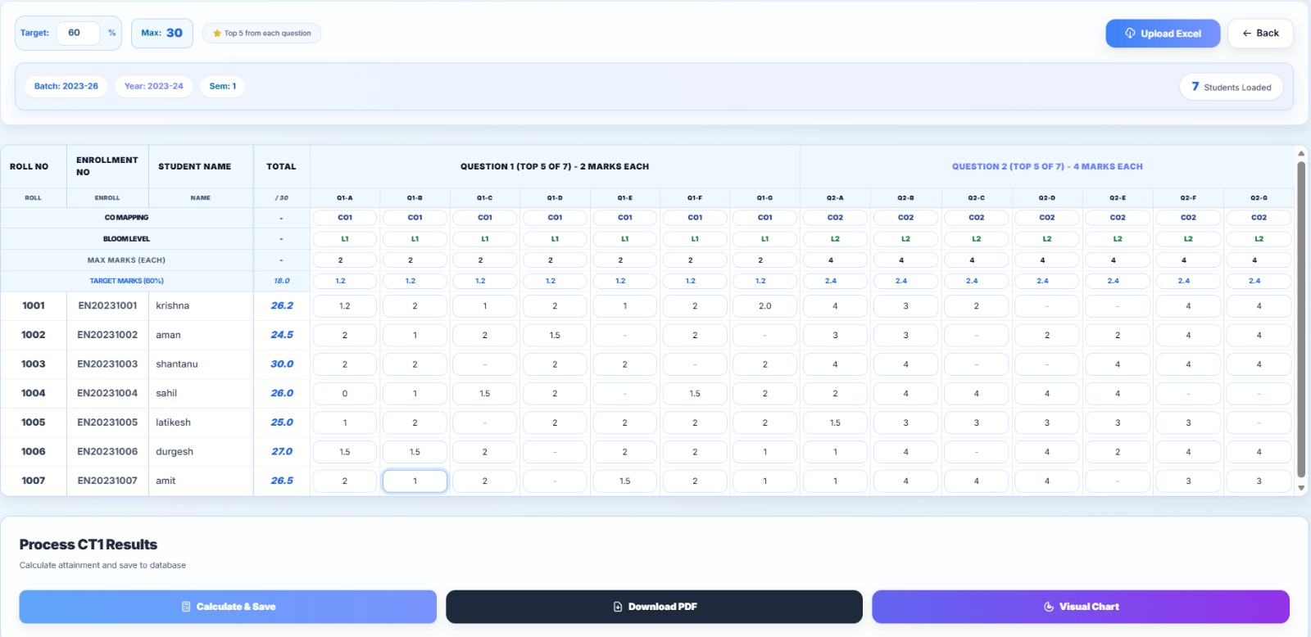
6. Results and Applications
Class Test Interface:- This interface is used for Class Test assessment, where teachers can enter student marks based on CO mapping. The system then calculates the results and provides attainment analysis, reports, and visual charts.

Slide 25
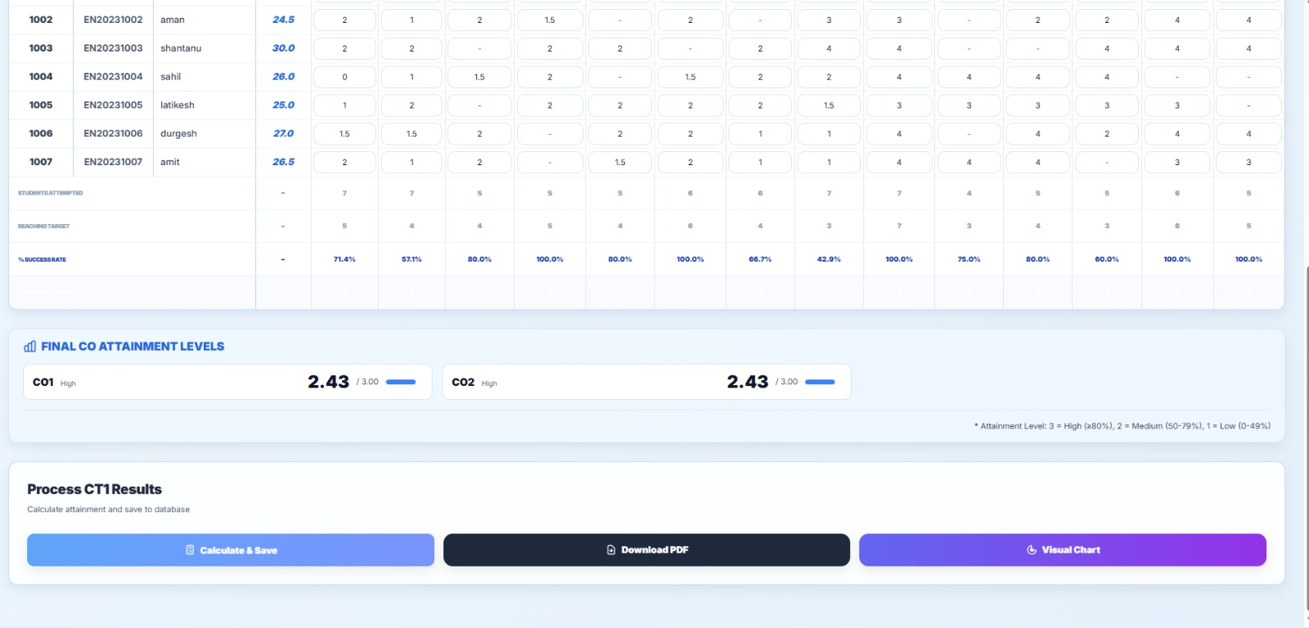
6. Results and Applications
This interface shows the final CO attainment levels calculated from the student marks entered in the assessment. It displays the attainment value for each CO and helps in evaluating the overall performance of students.

Slide 26
7. Conclusion and future scope
Conclusion:-
The proposed web-based CO attainment system provides a centralized and automated solution for monitoring Faculty Members performance. By allowing faculty to enter, manage and calculate CO data efficiently, the system ensures accurate and timely evaluation of learning outcomes.
The system also offers graphical visualization for target attainment and actual attainment, helping faculty identify performance gaps to improve Faculty Members performance by manually setting their action plan. Overall, the project saves time, enhances data-driven decision-making, and supports academic contributing to better teaching strategies effectiveness.

Slide 27
7. Conclusion and future scope
Future Scope :-
In future, the system can be extended to include Program Outcome (PO) and Program Specific Outcome (PSO) attainment for comprehensive academic evaluation. Advanced dashboards can be implemented to provide semester-wise and subject-wise performance trends using enhanced visual analytics. The system can also be enhanced to support student-wise performance analysis for personalized academic monitoring. Additionally, automated action plan recommendations based on identified gaps can be integrated to assist faculty in improving learning outcomes.

Slide 28
8. References and Bibliography
1. Bhivrabai Sawant Polytechnic.(NBA- National Board Of Acceredation)
Self Assessment Report (SAR) – Diploma in Computer Engineering.
Department of Computer Engineering, Pune, Maharashtra.
2.https://www.irjweb.com/CO%20AND%20PO%20ATTAINMENT%20CALCULATOR.pdf

